Slide 1
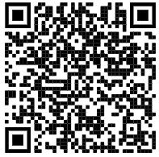

+++ Live +++ +++ Live +++ +++ Live +++
Welcome
to
Software Engineering
Lesson WS2022/2023
Starting at 14:15
survey

Slide 2

+++ Live +++ +++ Live +++ +++ Live +++
The rule No1
Keep your camera on

Slide 3
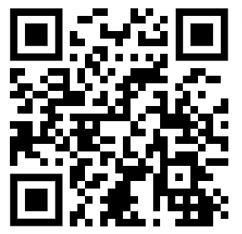
+++ Live +++ +++ Live +++ +++ Live +++
Software Engineering
WS-2022-2023
Lesson Mo.
14.15-15.45 h
16.00-17.30 h
17.45-19.15 h
Lab: Wed.
08.15-11.30 h
Room 8-A14
https://www.linkedin.com/groups/8689804

Slide 4
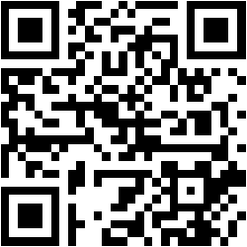
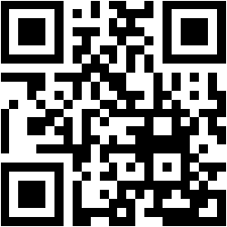
Building, running and debugging .NET Core applications
Damir Dobric
Microsoft Regional Director Microsoft Most Valuable Professional
Blog
Twitter
damir.dobric@daenet.com https://about.me/damirdobric

Slide 5
Evolution of .NET
.NET Framework Evolution (c-sharpcorner.com)

Slide 6
What is .NET Standard?
The .NET Standard is an API spec that describes the consistent set of .NET APIs that developers can expect in each .NET implementation
https://github.com/dotnet/standard/blob/master/docs/versions.md

Slide 7
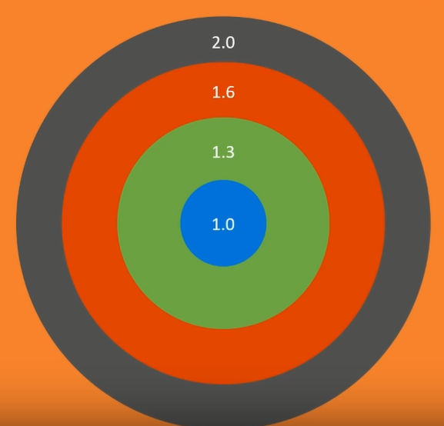
.NET Standard
PCL is common lowest denominator
Standard is replacement for PCL

Slide 8
Which standard should I support?
Number of APIs
Number of Applications
1.0
1.1
1.2
1.3
1.4
1.5
1.6
2.1

Slide 9
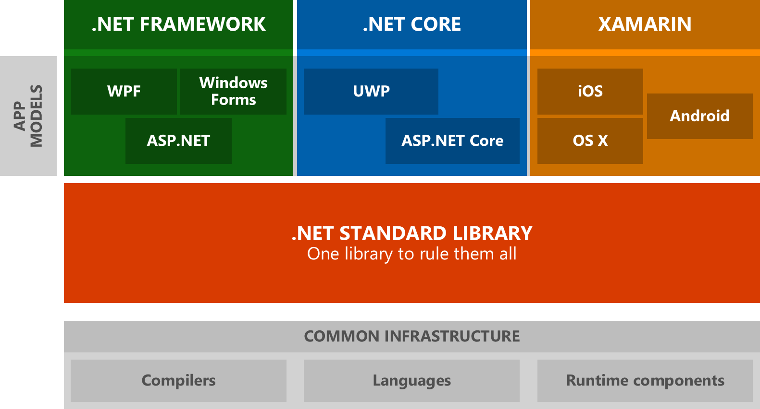

Slide 10
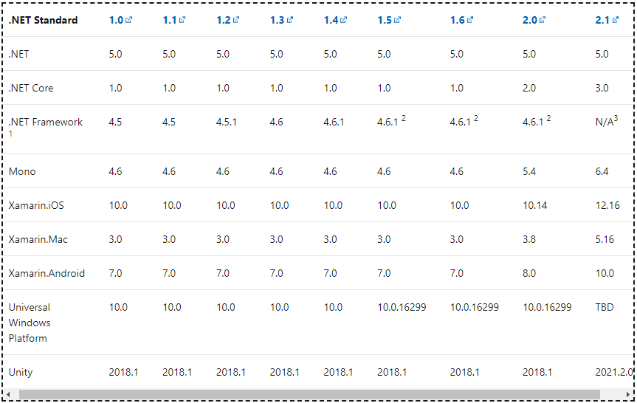
.NET Standard
https://docs.microsoft.com/en-us/dotnet/standard/net-standard

Slide 11
API Browser
https://docs.microsoft.com/en-us/dotnet/api/

Slide 12
Frameworks and Runtimes
Target Frameworks
You can build a library or an application
You build an application and must decide which set of APIs you want to use.
The framework is defined by the Target Framework Moniker (TMF).
https://docs.microsoft.com/en-us/dotnet/standard/frameworks
Target Runtimes
Used to identify target platforms where the application runs https://docs.microsoft.com/en-us/dotnet/core/rid-catalog

Slide 13
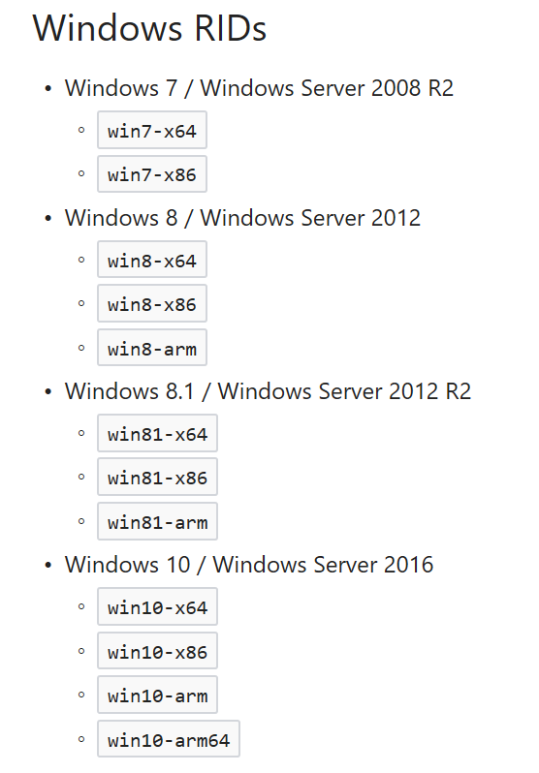
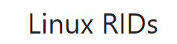
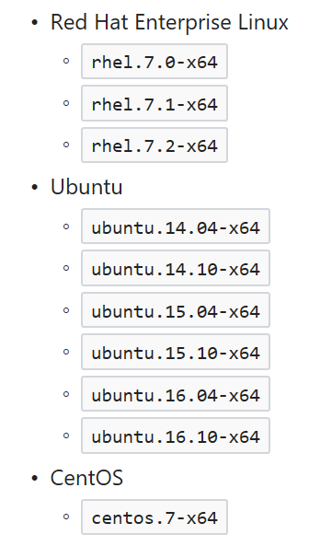
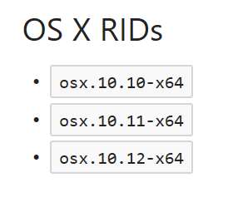
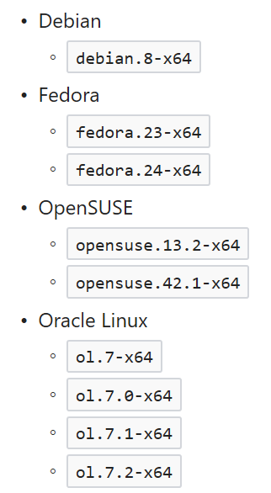
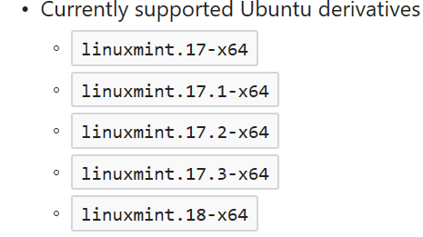
Currently Supported OS
https://docs.microsoft.com/en-us/dotnet/articles/core/rid-catalog

Slide 14
How to specify target runtime(s)?
<RuntimeIdentifiers>
win10-x64;osx.10.11-x64;debian-x64
</RuntimeIdentifiers>
>dotnet publish -r win10-x64
>dotnet publish -r osx.10.10-x64 –f netcoreapp2.0
>dotnet publish -r ubuntu.14.04-x64

Slide 15
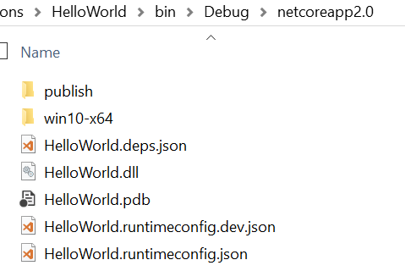
Build application
Build application:
C:\AppFolder>dotnet build
You application is still here ☺ in DLL
You can run it with: dotnet helloworld.dll

Slide 16
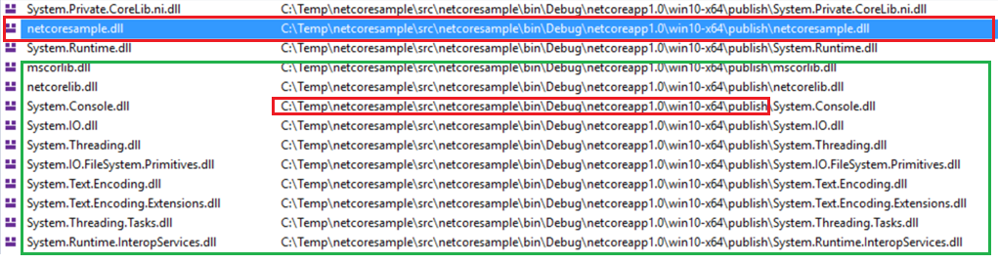
Run with dbl-click on .EXE
Application is still DLL
Framework is loaded from application path and not from installation.

Slide 17
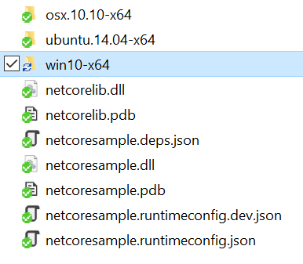
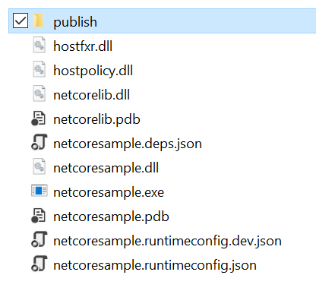
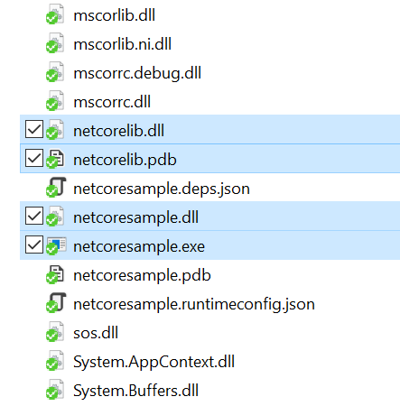
Build Self-Contained Application
Framework Dependent (default)
Build application:
C:\AppFolder>dotnet build
Framework INDependent = Self-Contained
Build application:
C:\AppFolder>dotnet publish –r win10-x64
C:\AppFolder>dotnet publish –r win10-x86
C:\AppFolder>dotnet publish –r ubuntu.14.04-x64
C:\AppFolder>dotnet publish –r ubuntu.14.04-x64
All framework assemblies are deployed with application.

Slide 18
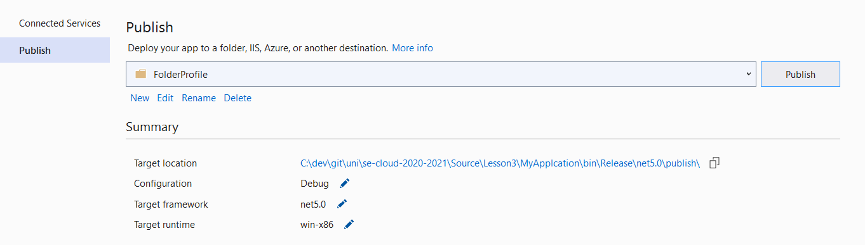
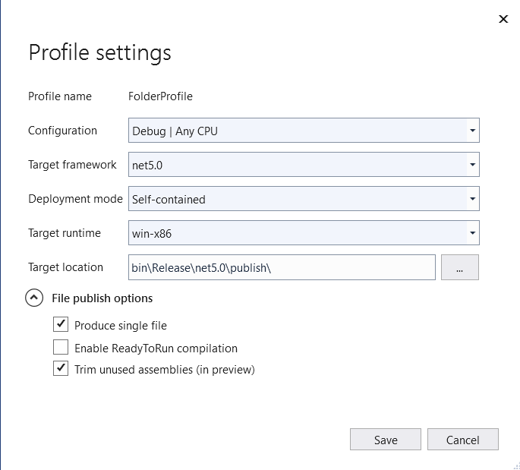
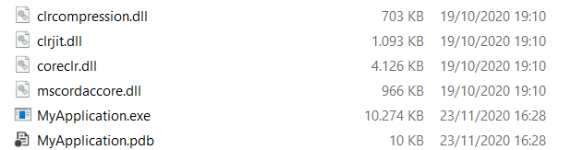
Publish as a Single File

Slide 19
Working with objects
public class MyClass {
public double SomeMethod(int a, int b) { return a / b;
}
}

Slide 20
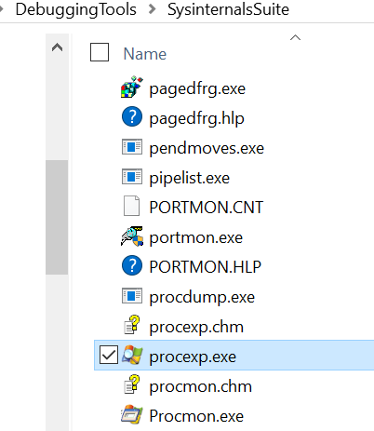
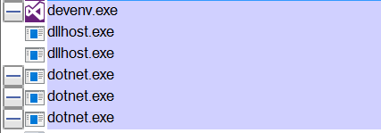
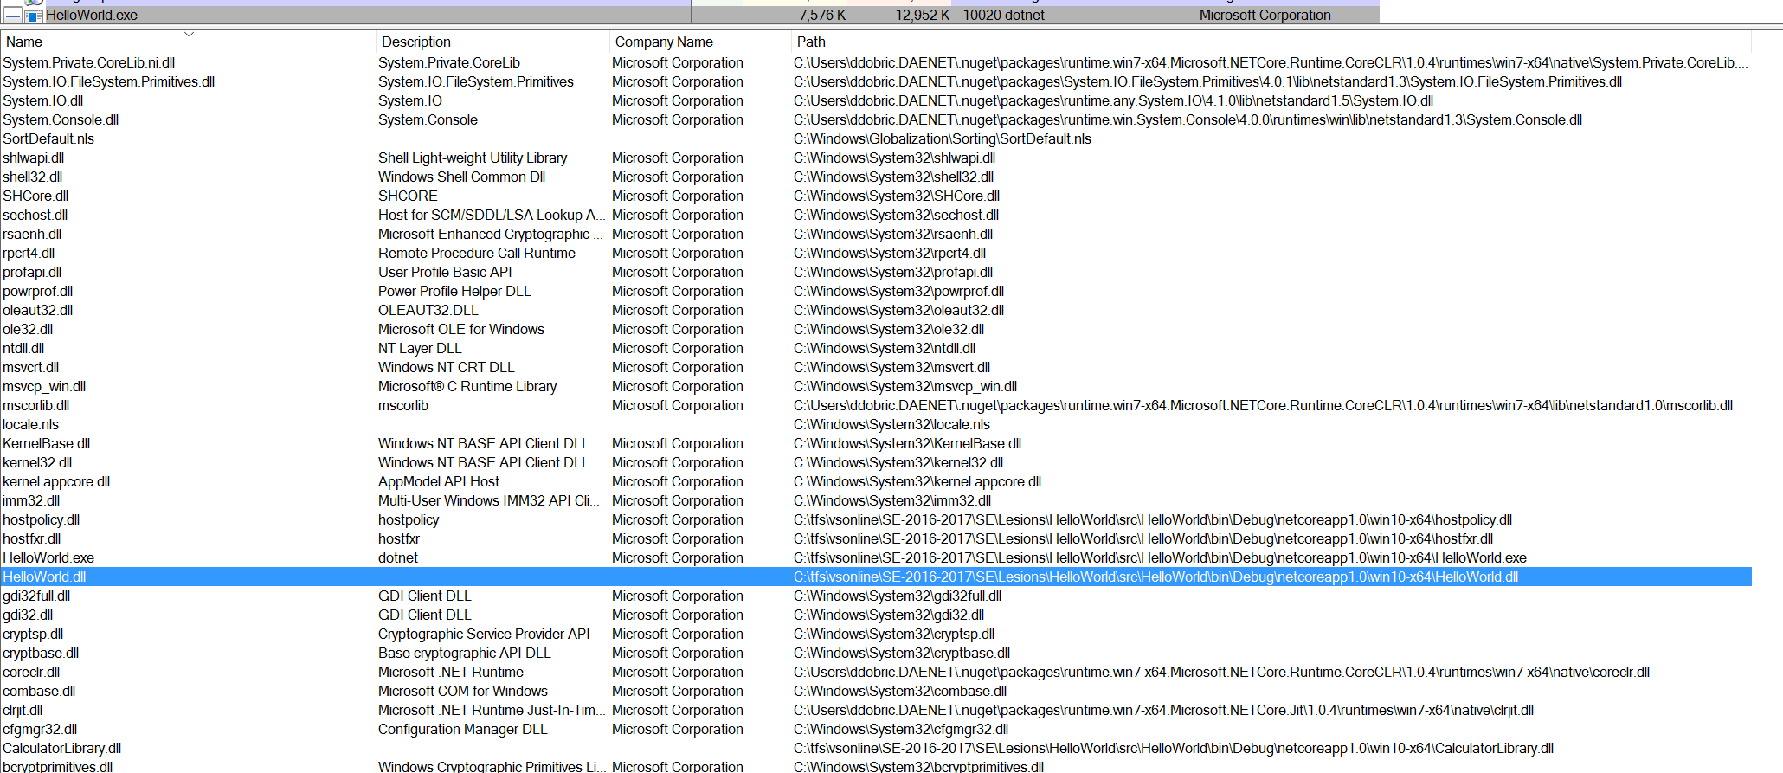
Process Explorer

Slide 21
Exercises
E5 - Framework Independent Build
E6 - Working with Debugger

Slide 22
(E5) Framework Independent Build
Open you HelloWorld application.
Change project file as follows
<RuntimeIdentifiers>
win10-x64;osx.10.11-x64;debian-x64
</RuntimeIdentifiers>
Open Command line in application root and execute ‘dotnet publish’:
>dotnet publish -r win10-x64
>dotnet publish -r osx.10.10-x64 –f netcoreapp2.0
>dotnet publish -r ubuntu.14.04-x64
… continued on next slide…

Slide 23
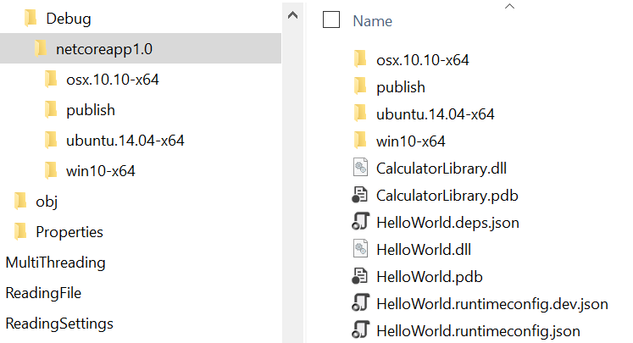

After publish…
Notice build for all runtimes (win, ox and linux)
Navigate to windows runtime folder.
… continued on next slide…

Slide 24
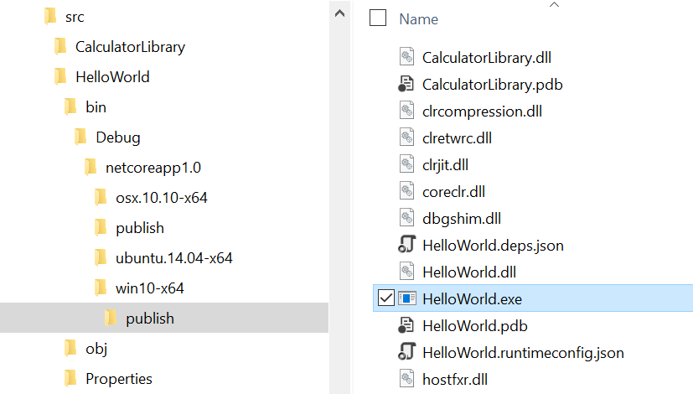
How and what to run?
Navigate to ‘win10-x64/publish’ folder.
Locate EXE and start it.

Slide 25
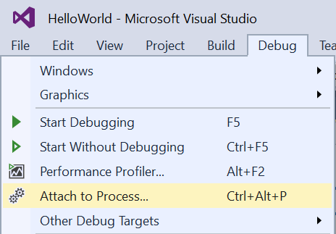
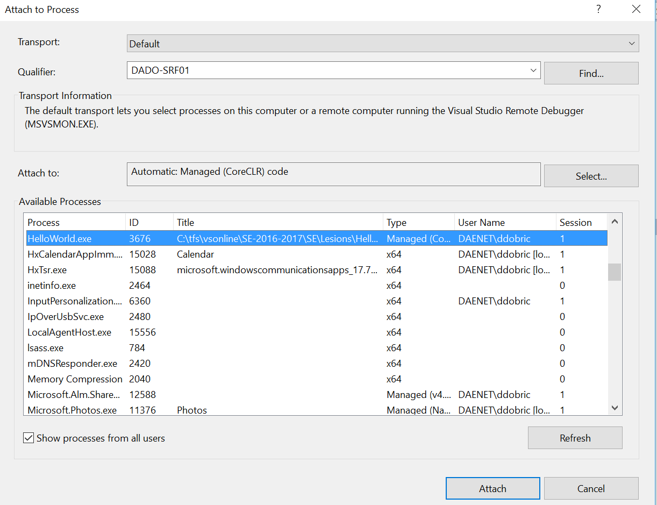
(E6) Working with Debugger

Slide 26
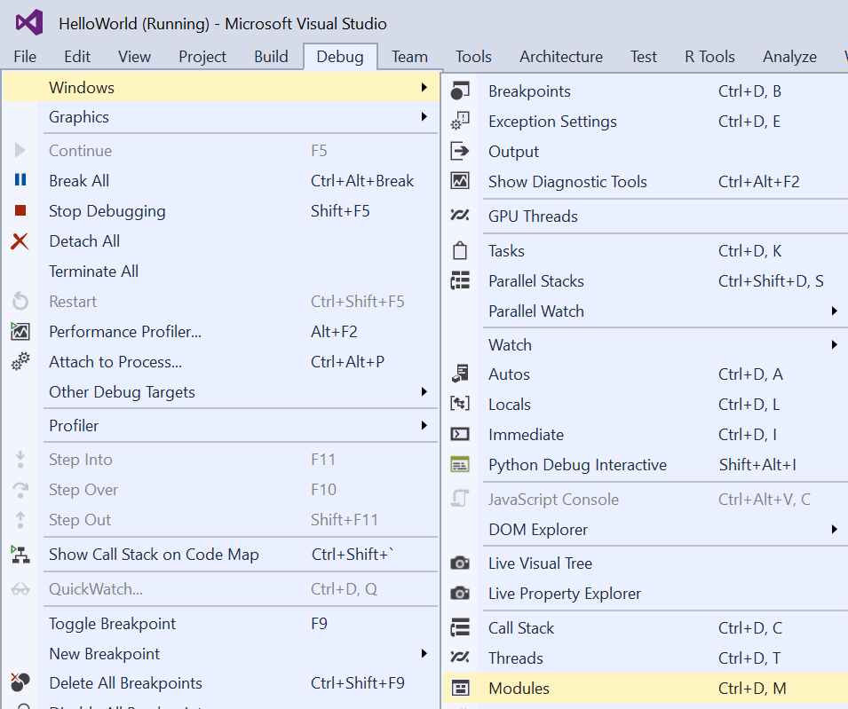
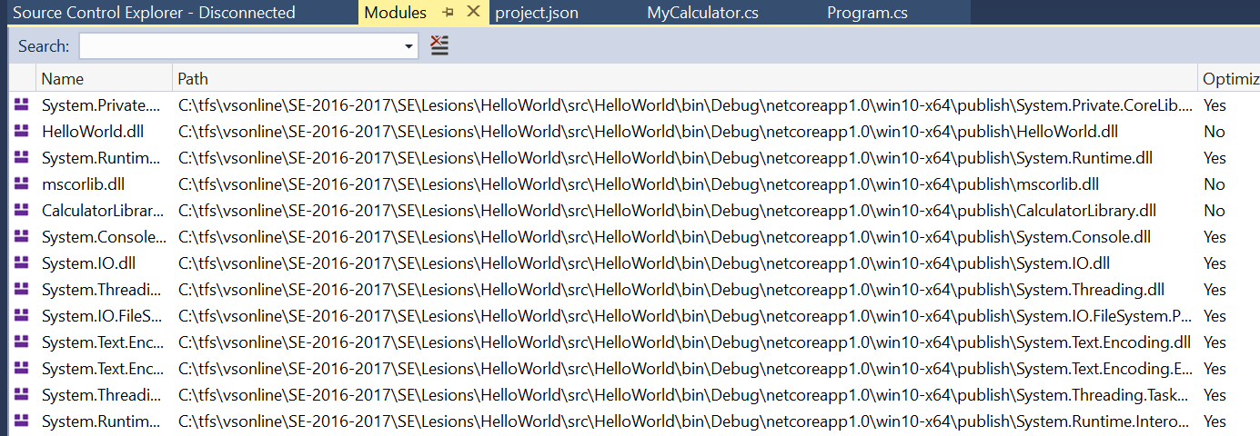
Explore loaded modules

